Slide 1
Student Details
Name : VEERAVALLI SURYA NAVEEN
SKILLSBUILD EMAIL ID : naveen534245@gmail.com
College name : Sagi ramakrishnam raju engineering college
College state : Andhra Pradesh
Internship domain : artificial intelligence
Internship start and end date : 18-08-2023 and 30-09-2023

Slide 2

PROJECT TITLE/Problem Statement
Restaurant Review Sentiment Analysis
Many people rely on online reviews when deciding where to dine, making restaurant reviews a crucial aspect of the hospitality industry.
However, manually sorting through countless reviews to gauge customer sentiment can be time-consuming and impractical.
Therefore, we need an automated Sentiment Analysis system to help restaurants and consumers quickly understand the sentiment behind these reviews.

Slide 3

AGENDA
The agenda for conducting a restaurant review sentiment analysis involves several key steps: Firstly, data collection, including gathering a diverse set of restaurant reviews from various sources, such as online platforms and social media. Next, data preprocessing to clean and prepare the text data for analysis, including tokenization and removing stopwords. Then, sentiment analysis using natural language processing techniques to determine the sentiment (positive, negative, or neutral) expressed in each review. Additionally, feature engineering may be performed to extract relevant information like keywords or aspects of the restaurant experience (e.g., food quality, service, ambiance). Finally, the results are analyzed to provide insights into customer sentiments, identify areas for improvement, and inform decision-making for the restaurant's management.

Slide 4
PROJECT OVERVIEW
The restaurant review sentiment analysis project aims to utilize natural language processing (NLP) techniques to assess and understand customer sentiments expressed in online reviews of various restaurants.
By collecting and preprocessing a diverse dataset of restaurant reviews, the project will employ sentiment analysis algorithms to categorize the sentiments as positive, negative, or neutral, shedding light on customer satisfaction levels.
Additionally, the project will employ feature engineering to extract valuable insights, such as identifying specific aspects of the dining experience that customers frequently comment on, such as food quality, service, and ambiance.
The ultimate goal is to provide actionable insights to restaurant owners and managers, enabling them to make data-driven decisions to enhance customer experiences and improve overall business performance.

Slide 5
WHO ARE THE END USERS of this project?
Restaurant Owners and Managers: Restaurant owners and managers can use the sentiment analysis results to gain insights into customer opinions and identify areas for improvement in their establishments, such as addressing specific service or food quality issues.
Consumers: Consumers can also be end users indirectly as they may access aggregated sentiment analysis results when making dining decisions, helping them choose restaurants that align with their preferences and expectations.
Competitors: Competitors and industry analysts can use sentiment analysis to compare customer perceptions of different restaurants, helping them understand market trends and competitive positioning.
Food Critics and Bloggers: Food critics and bloggers may use sentiment analysis to validate or complement their own reviews and gain a deeper understanding of popular restaurant trends and customer sentiments.
Researchers and Academics: Researchers in the fields of natural language processing (NLP) and sentiment analysis may also be end users, as they can use the project's findings to advance their studies and methodologies.

Slide 6
YOUR SOLUTION AND ITS VALUE PROPOSITION
Our sentiment analysis solution for restaurant reviews offers a powerful tool to extract valuable insights from vast amounts of customer feedback. By employing advanced natural language processing techniques, we categorize sentiments into positive, negative, or neutral, enabling restaurant owners and managers to make data-driven decisions that improve the overall dining experience.
Our solution not only identifies areas for improvement but also highlights strengths, allowing businesses to enhance their competitive edge. With actionable insights and real-time feedback analysis, we empower our users to increase customer satisfaction, boost revenues, and build stronger customer relationships, ultimately driving the success of their restaurants.

Slide 7
How did you customize the project and make it your own
Firstly, defining the objectives and scope of the project. Consider the types of insights like focusing on a specific cuisine, geographical area. Additionally, you can customize the sentiment analysis algorithms and features to align with your unique requirements beyond standard online reviews.
By customizing the project to your specific goals and constraints, you can ensure that it delivers insights and value that are directly relevant to your business or research objectives.
Furthermore, personalizing the project involves selecting the right tools and technologies that best fit your resources and expertise. Depending on your team's capabilities and available resources, you can choose from a range of NLP libraries, machine learning frameworks, and data preprocessing tools to build a tailored solution.
Whether you're focusing on real-time analysis, historical data, or scalability, the choice of technology stack should align with your specific use case. By carefully customizing both the project's scope and technology stack, you can create a sentiment analysis solution that is uniquely yours and capable of addressing your specific needs and goals in the restaurant industry or any other domain of interest.

Slide 8
MODELLING
Multinomial Naive Bayes algorithm
A probabilistic classification algorithm well-suited for text classification tasks, such as sentiment analysis.
Assumes that the features of the data are independent of each other.
Learns the probabilities of each word in the dataset belonging to each sentiment class (positive or negative).
Predicts the sentiment of a new review by calculating the probability of the review belonging to each sentiment class and then predicting the class with the highest probability.
Benefits of using the MNB algorithm for restaurant sentiment analysis
Simple to implement and train.
Able to learn from even a relatively small dataset of labeled reviews.
Effective for text classification tasks.

Slide 9
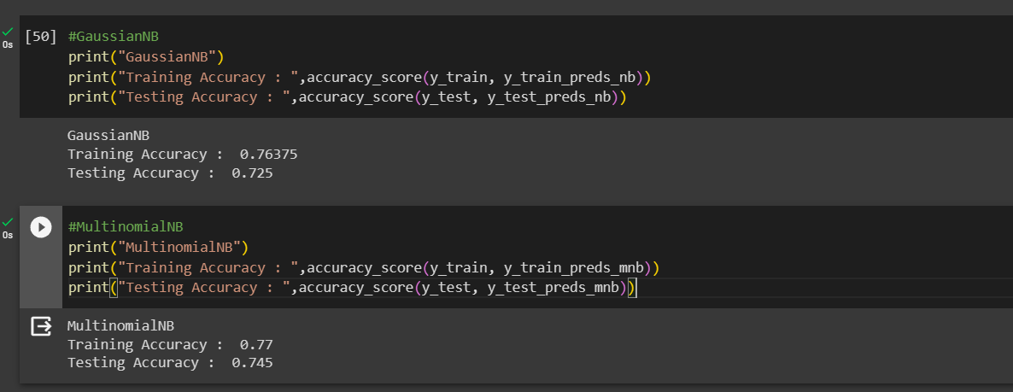
Results

Slide 10
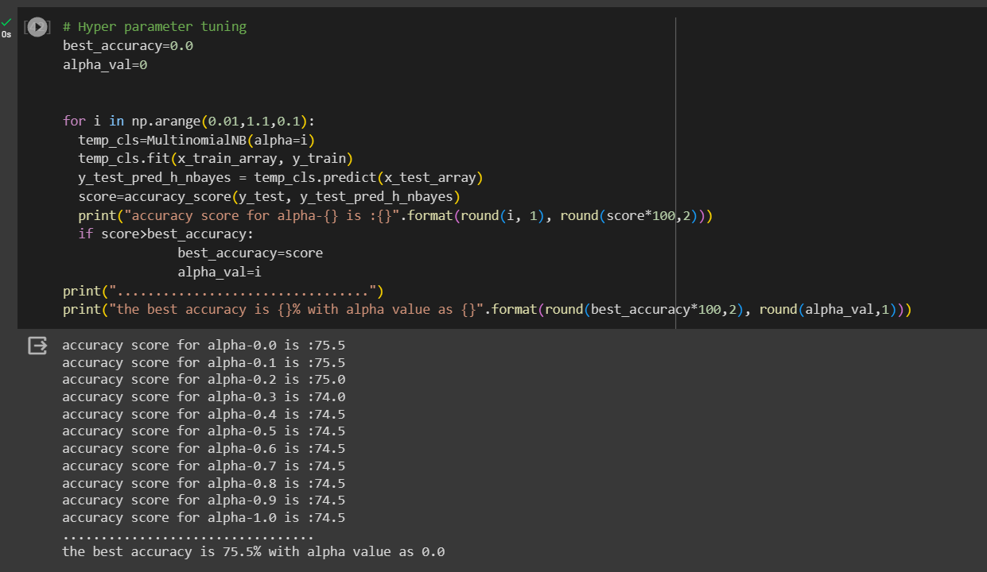
Results

Slide 11
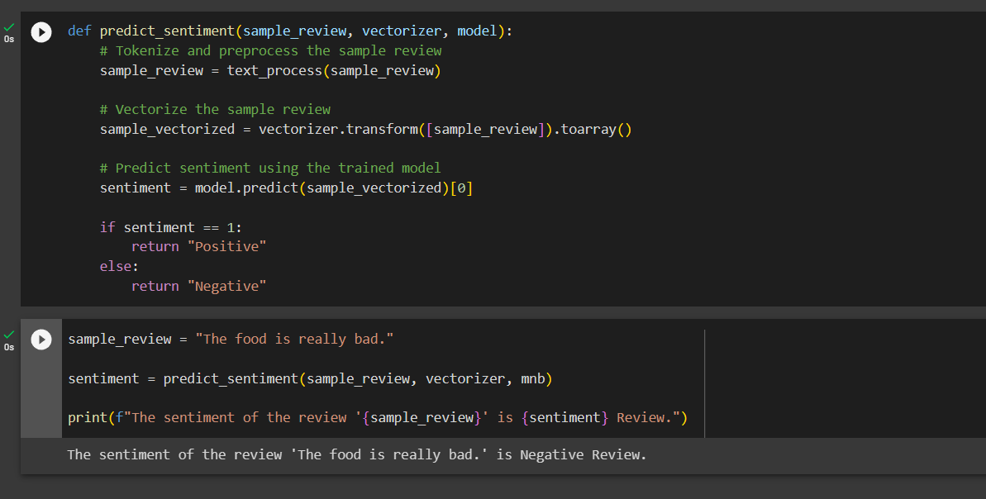
Results

Slide 12
links
https://colab.research.google.com/drive/1IqGlJ-4LRrMuwWojCrgMvjYwLGB115LR?usp=sharing

